Slide 1
Chicago vs. New york
Group B: Hai Anh Le
Neha Shashidhara
Jeevan Sai

Slide 2


Introduction:
Both have large sets of data.
We were able to write queries to filter and categorize top important information.
Dataset size: 1.52GB
Dataset size: 1.46GB

Slide 3
Objectives:
Learning how to use HiveQL and Tableau to:
Filter out top 3 crimes in Chicago and New York, 2006-2017.
Visualize which street has the highest crime and which has the lowest in both cities.
Interesting fact after analyzing yearly crime rate in both cities.
Comparison/forecasting.

Slide 4
Specification:
Cluster version: IOP4.2
No of nodes: 2 (management and data nodes)
Memory size: RAM 72GB, data disk 1TB SATA
CPU Speed: 2.10GHz
Data is pulled from 2006 until 2017. Original data is updated weekly.
https://data.cityofnewyork.us/api/views/qgea-i56i/rows.csv?accessType=DOWNLOAD&bom=true&format=true
https://data.cityofchicago.org/api/views/ijzp-q8t2/rows.csv?accessType=DOWNLOAD&bom=true&format=true

Slide 5




Data processing

Slide 6
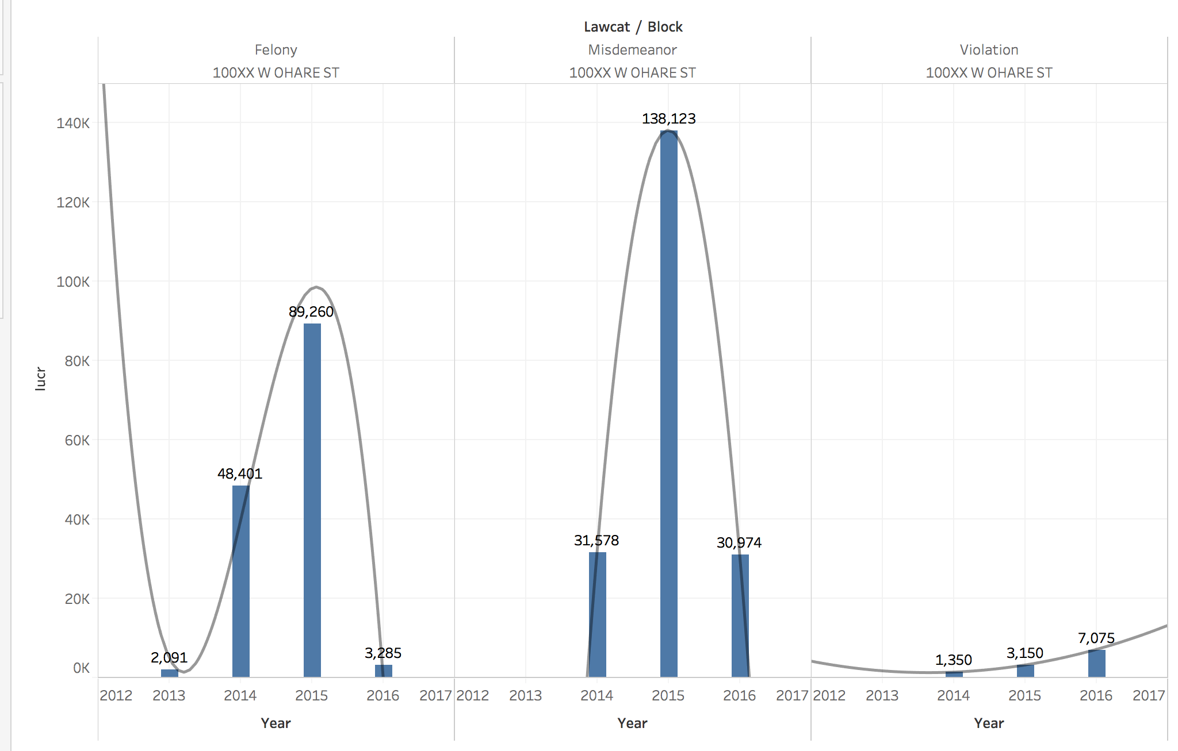
Chicago
Top 3 crimes in Chicago: felony, misdemeanor, and violation.

Slide 7
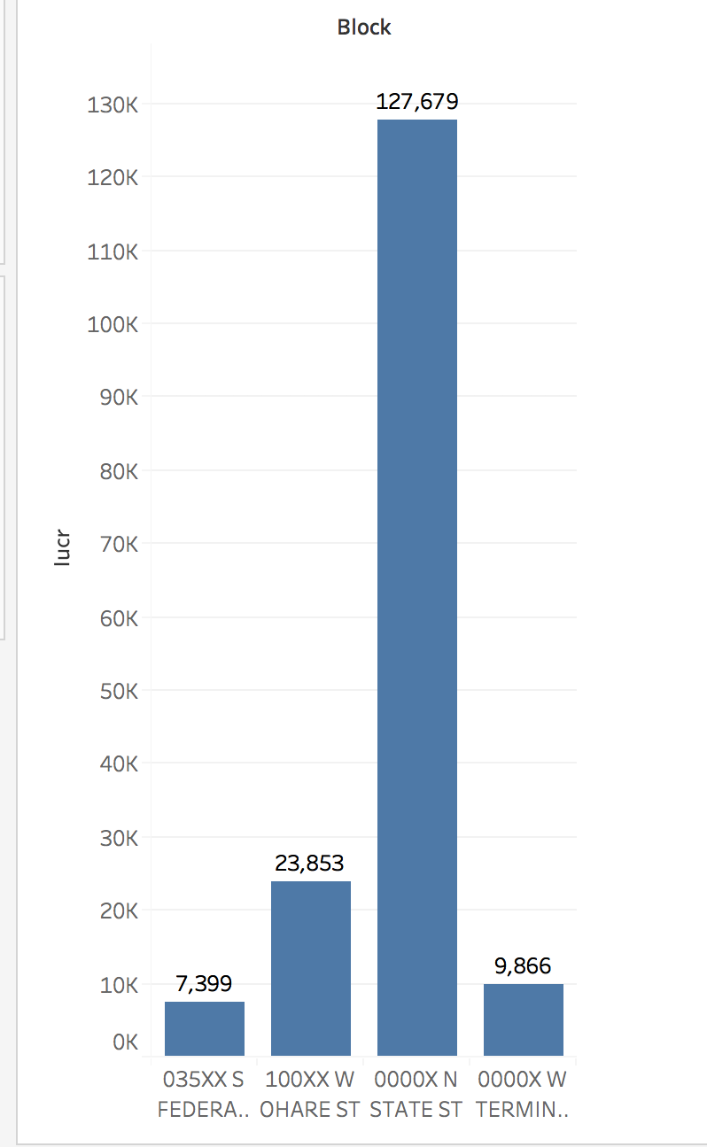
Top crimestreets in Chicago
The streets in illustrated in the graph represent the most dangerous areas in Chicago with the highest crime rates. State st. is the highest. Federal st. is the lowest.

Slide 8
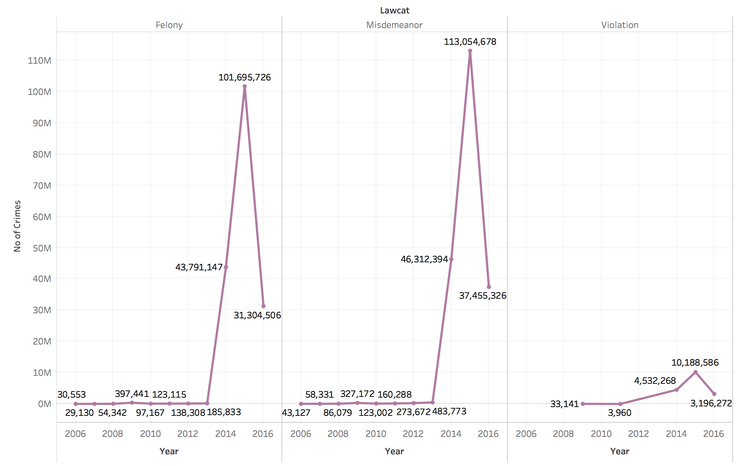
Yearly crime in chicago
In 2015, both felony and misdemeanor rose extremely high.
It also significantly decreased by 2016.

Slide 9
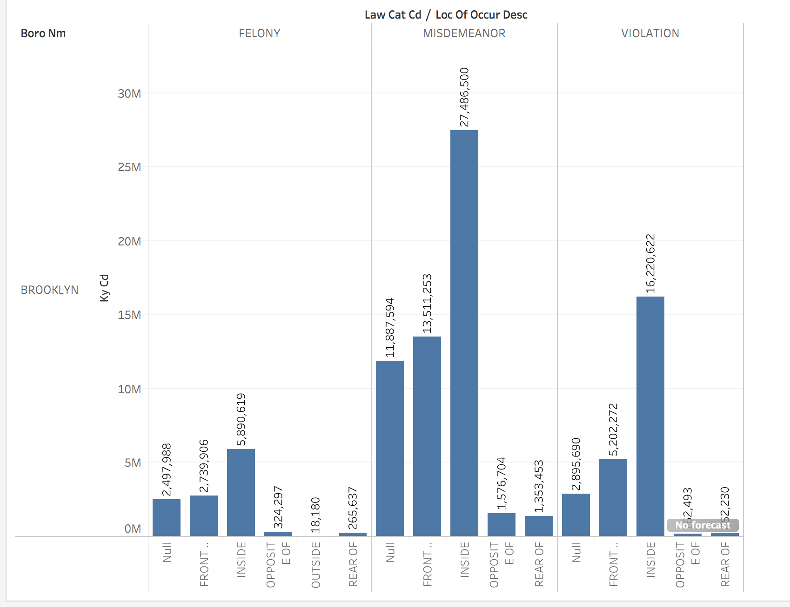
New York city
Based on Chicago, we also explored the same 3 categories of crimes in NYC as felony, misdemeanor, and violation.

Slide 10
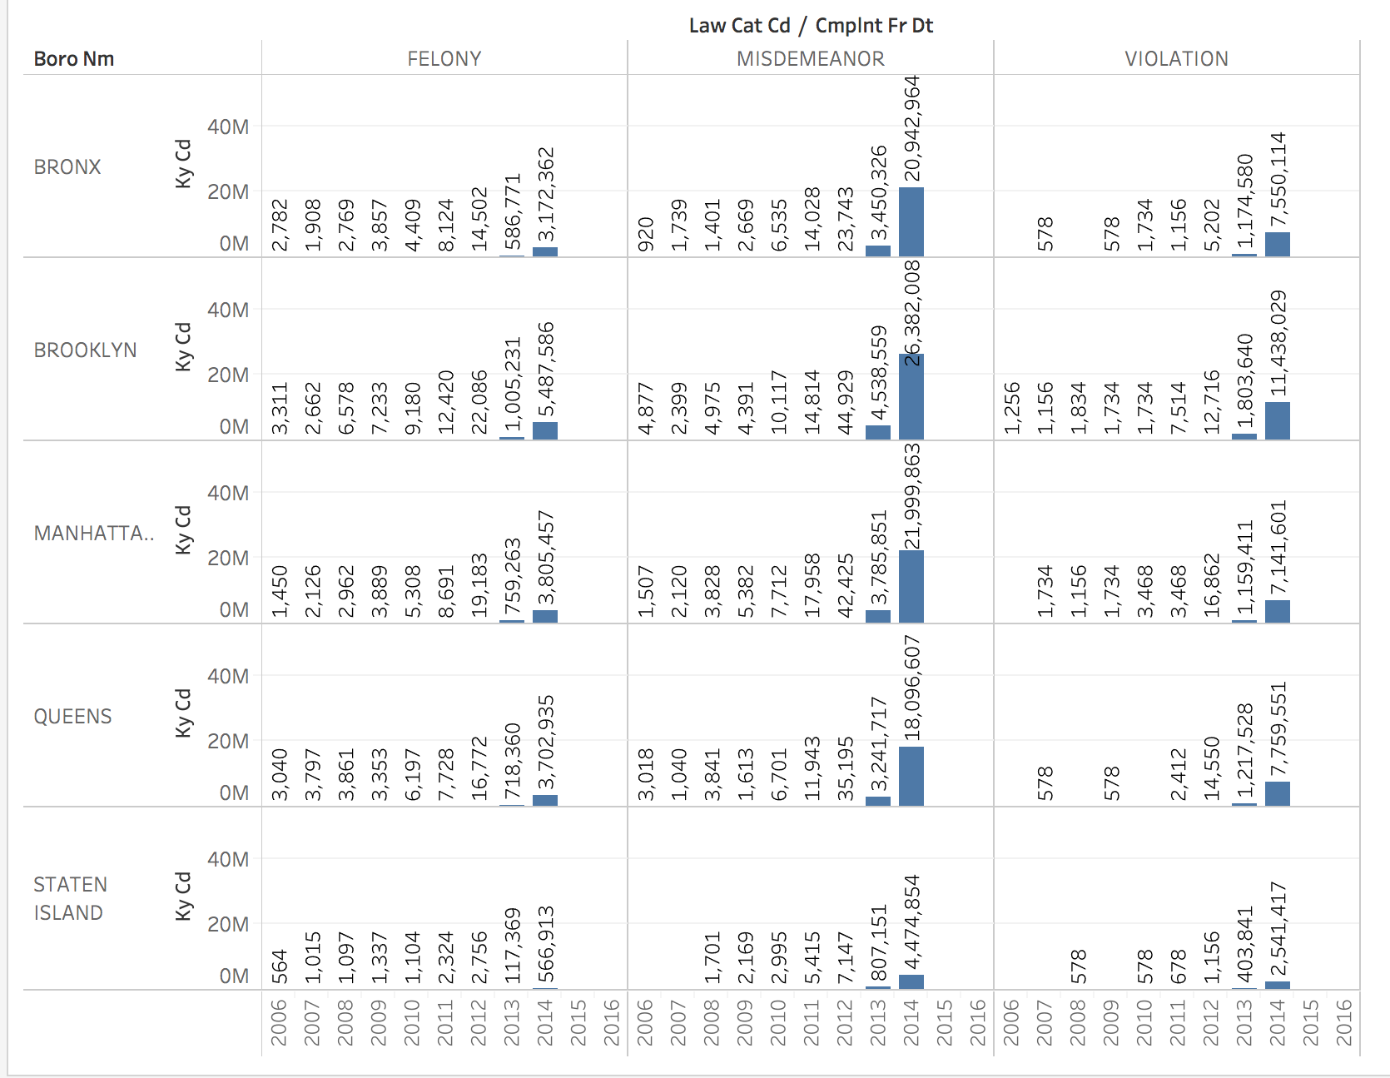
Top crime streets in NYC
The year 2014 is when felony, misdemeanor and violation happened the most.
The number are significantly high, up to millions in every category. While in Chicago, it’s in thousands.
Brooklyn is the highest and Staten Island is the lowest.

Slide 11

Interesting fact:
Despite the fact that when compare the three top dangerous cities in Chicago and NYC, New York seems to be more dangerous.
HOWEVER… when it comes to yearly crime rate, we have a surprise winner!

Slide 12

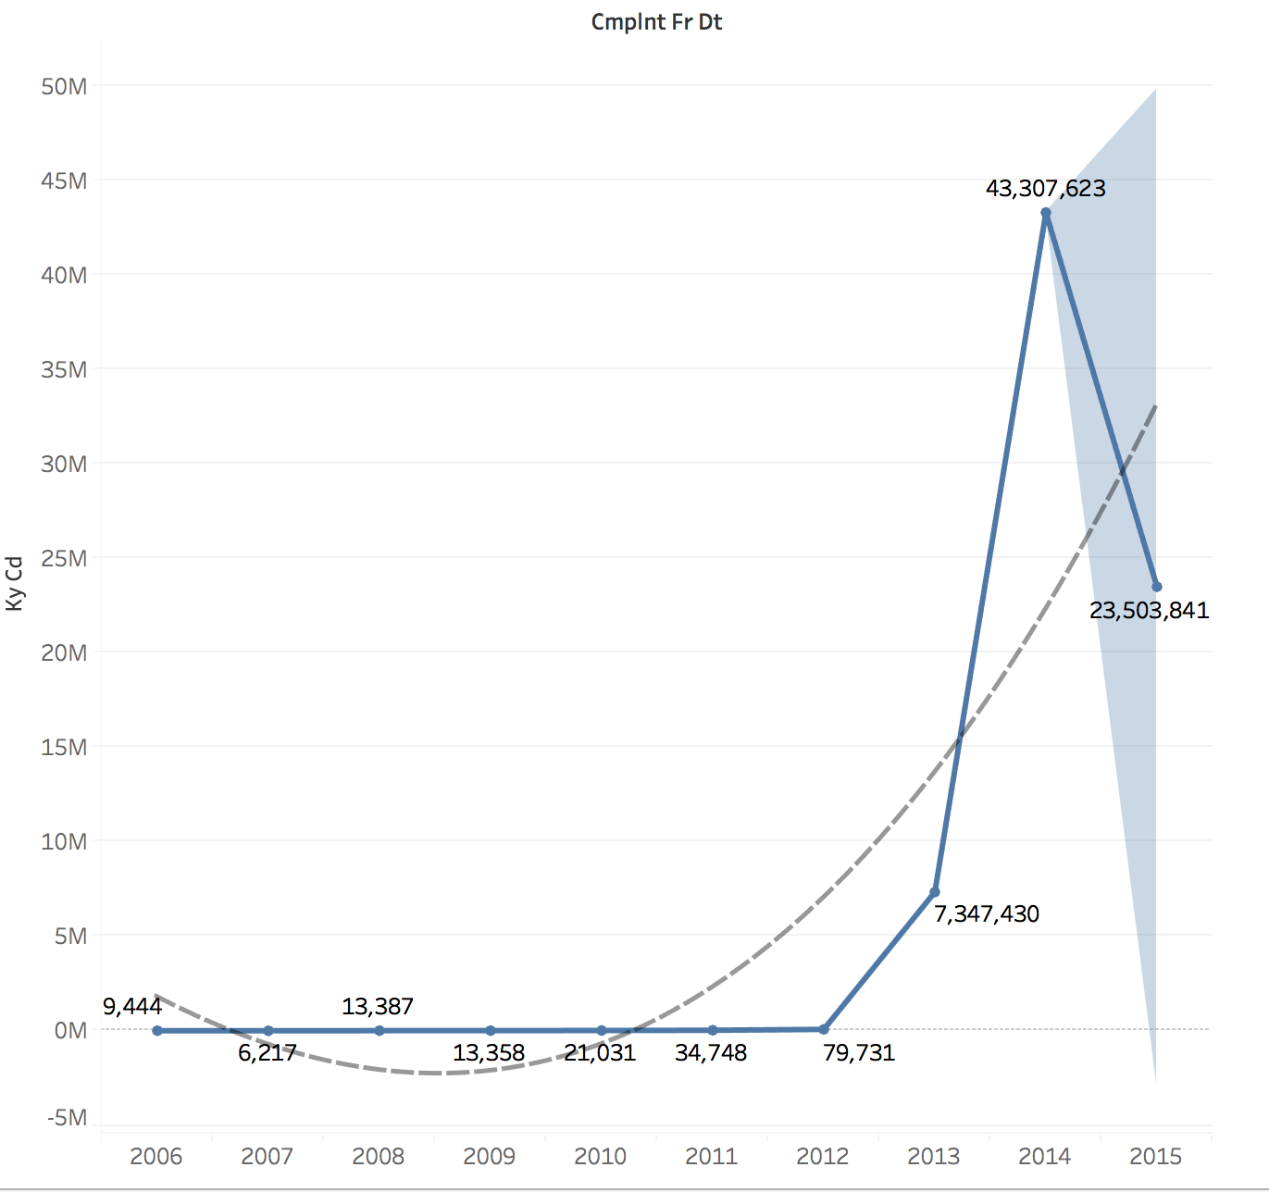
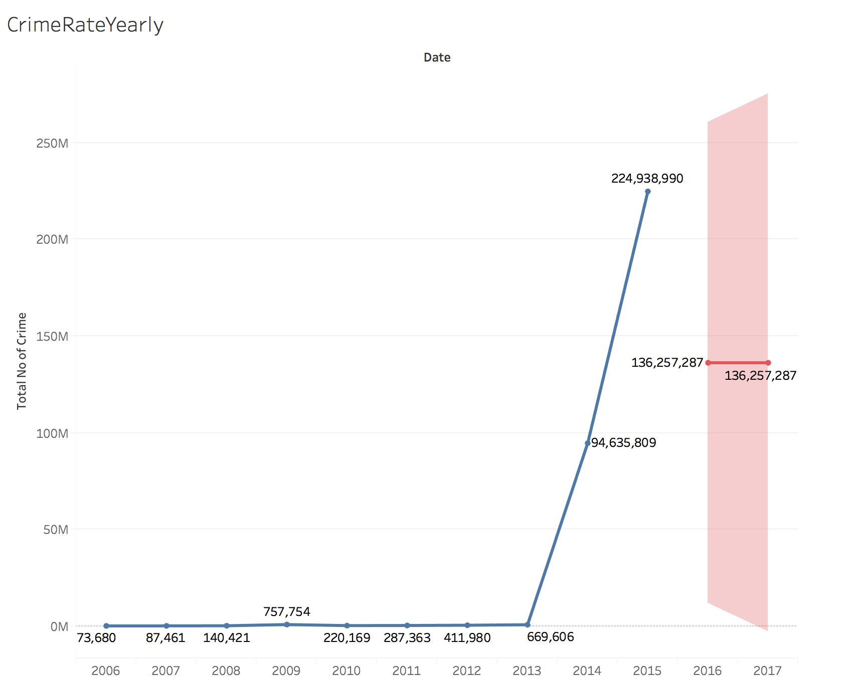
Forecasting/comparing
New York
Chicago

Slide 13
Conclusion:
New York has higher crime rates in the top 5 cities than Chicago.
But yearly, Chicago is more dangerous in the 3 crime categories: felony, misdemeanor, and violation.
Crime rate has significantly increased the recent years.
Be careful while visiting those areas.

Slide 14
References:
NYC Open data:
https://data.cityofnewyork.us/api/views/qgea-i56i/rows.csv?accessType=DOWNLOAD&bom=true&format=true
Chicago Data Portal:
https://data.cityofchicago.org/api/views/ijzp-q8t2/rows.csv?accessType=DOWNLOAD&bom=true&format=true
Imagines courtesy of Google.
Grand data source:
http://www.calstatela.edu/centers/hipic/related-site
IBM Bluemix:
https://console.bluemix.net/data/bic/
Github link:
https://github.com/annsummer94/mastercoder.git

Slide 15


